Slide 1
Search Engine for Text Documents
Supervisor: Eng/ Esraa Maged

Slide 2
Team Members
Kareem Abdel-Muttalib
Mohamed Magdy
Hossam Nasr
Ahmed Moustafa
Salma Yasser
Ola Farhat

Slide 3
Table of contents
Introduction & Project Overview
Technologies, Tools & Features
01.
02.
Core Modules & Logic
Demo & Output
03.
04.

Slide 4
Introduction & Project Overview
01.

Slide 5
Introduction
Search engines play a vital role in helping users find relevant information in large text collections. This project explores how a search engine works by building a simplified version focused on document retrieval. It combines core natural language processing techniques with efficient indexing and ranking methods. The goal is to offer accurate, ranked results for a user's query. By handling everything from preprocessing to result display, this project demonstrates how search technology can be applied using basic tools and algorithms.

Slide 6
Project Overview
The project is built using Python and organized into four main modules: preprocessing, indexing, retrieval, and a user interface. Text documents are cleaned and tokenized before being indexed using techniques like the Document-Term Matrix, Inverted Index, and TF-IDF. When a user enters a query, the engine ranks documents using cosine similarity and displays the results through a Streamlit web app. The modular design makes it easy to understand each part of the pipeline while showcasing the practical use of NLP and information retrieval in real applications.

Slide 7
Technologies, Tools & Features
02.

Slide 8
Languages & Frameworks
Dataset
Libraries
Course materials from the IS Strategy class used as the searchable document collection.
Python, Streamlit
NLTK, NumPy, scikit-learn,streamlit, etc.

Slide 9
Key Features
Clean and interactive UI with Streamlit
4
1
Preprocessing with NLP
3
2
Ranked search using Cosine Similarity
Multiple indexing methods (Inverted Index, TF-IDF)

Slide 10
Core Modules & Logic
03.

Slide 11
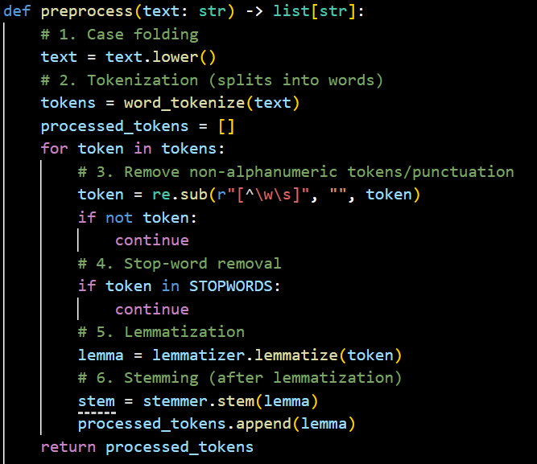
Preprocessing

Slide 12
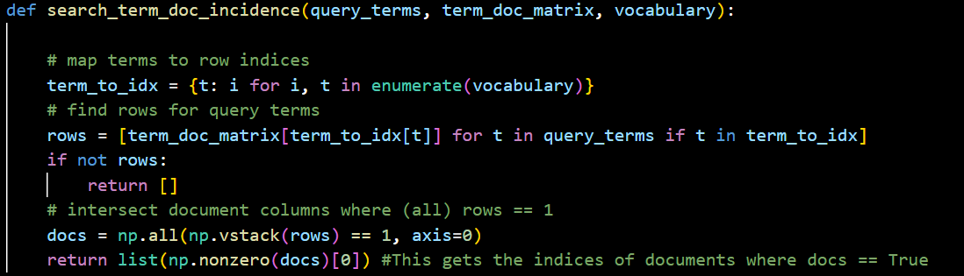
Search term_doc_incidence

Slide 13
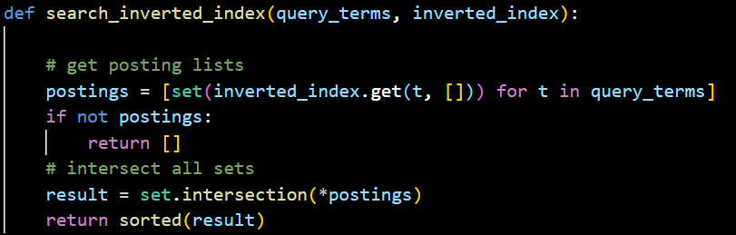
Search inverted_index

Slide 14
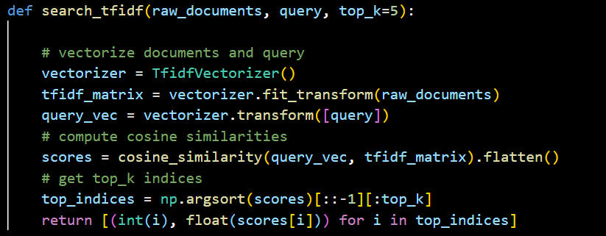
Search tfidf

Slide 15
Demo & Output
04.

Slide 17
Thanks!

Slide 18
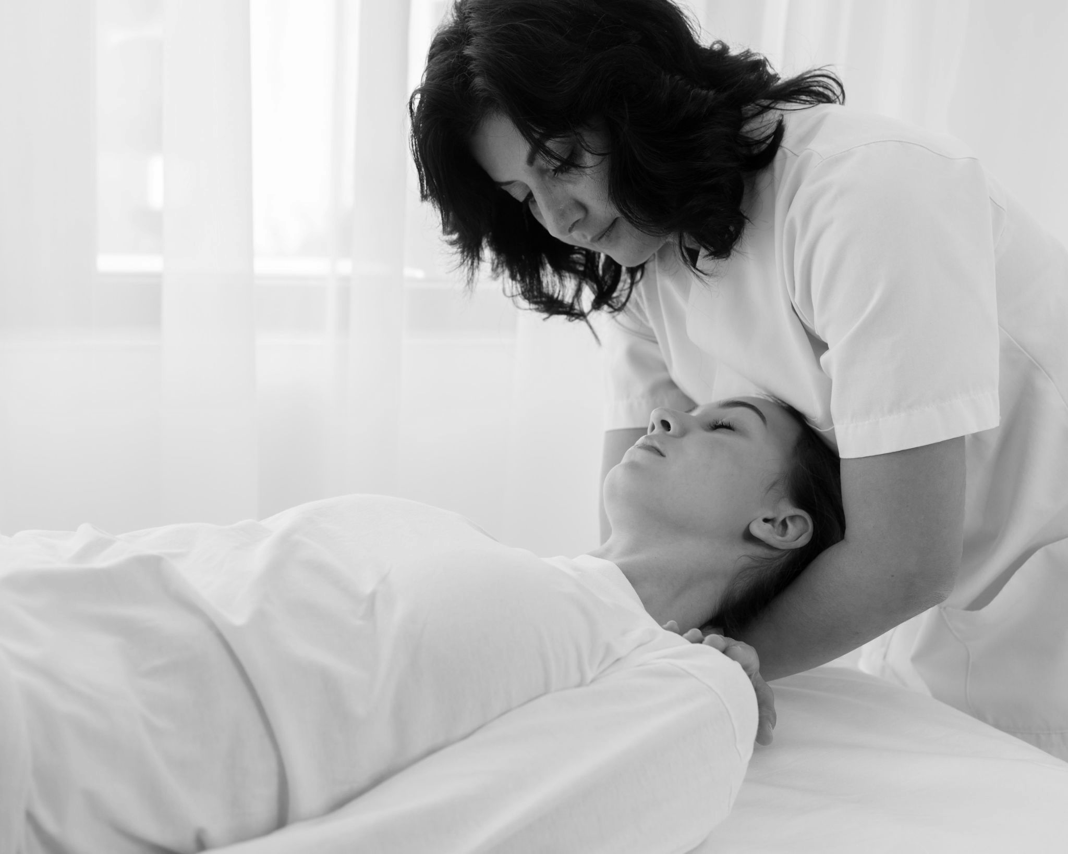
Our center
You can give a brief description of the topic you want to talk about here. If you want to talk about Mercury, you can say that it’s the smallest planet of them all

Slide 19
Mission
Vision
Mercury is the closest planet to the Sun and the smallest one in the Solar System—it’s only a bit larger than the Moon
Venus has a beautiful name and is the second planet from the Sun. It’s hot and has a poisonous atmosphere

Slide 20
—Someone Famous
“This is a quote, words full of wisdom that someone important said and can make the reader get inspired.”

Slide 21
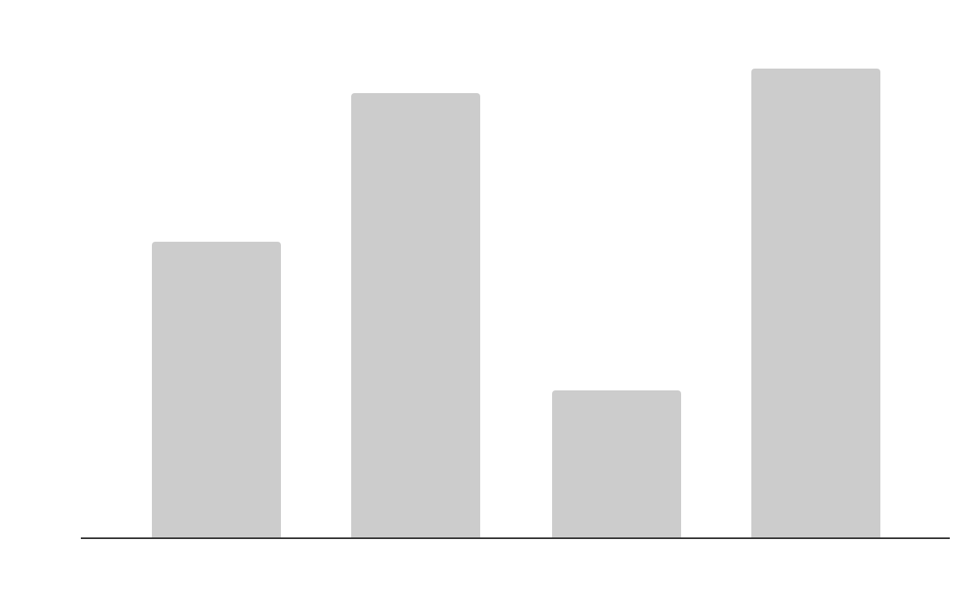
This is a graph
Mercury
Jupiter
It’s the closest planet to the Sun
Jupiter is the biggest planet of them all
Venus
Saturn
Venus is the second planet from the Sun
Saturn is a gas giant and has several rings
Follow the link in the graph to modify its data and then paste the new one here. For more info, click here

Slide 22
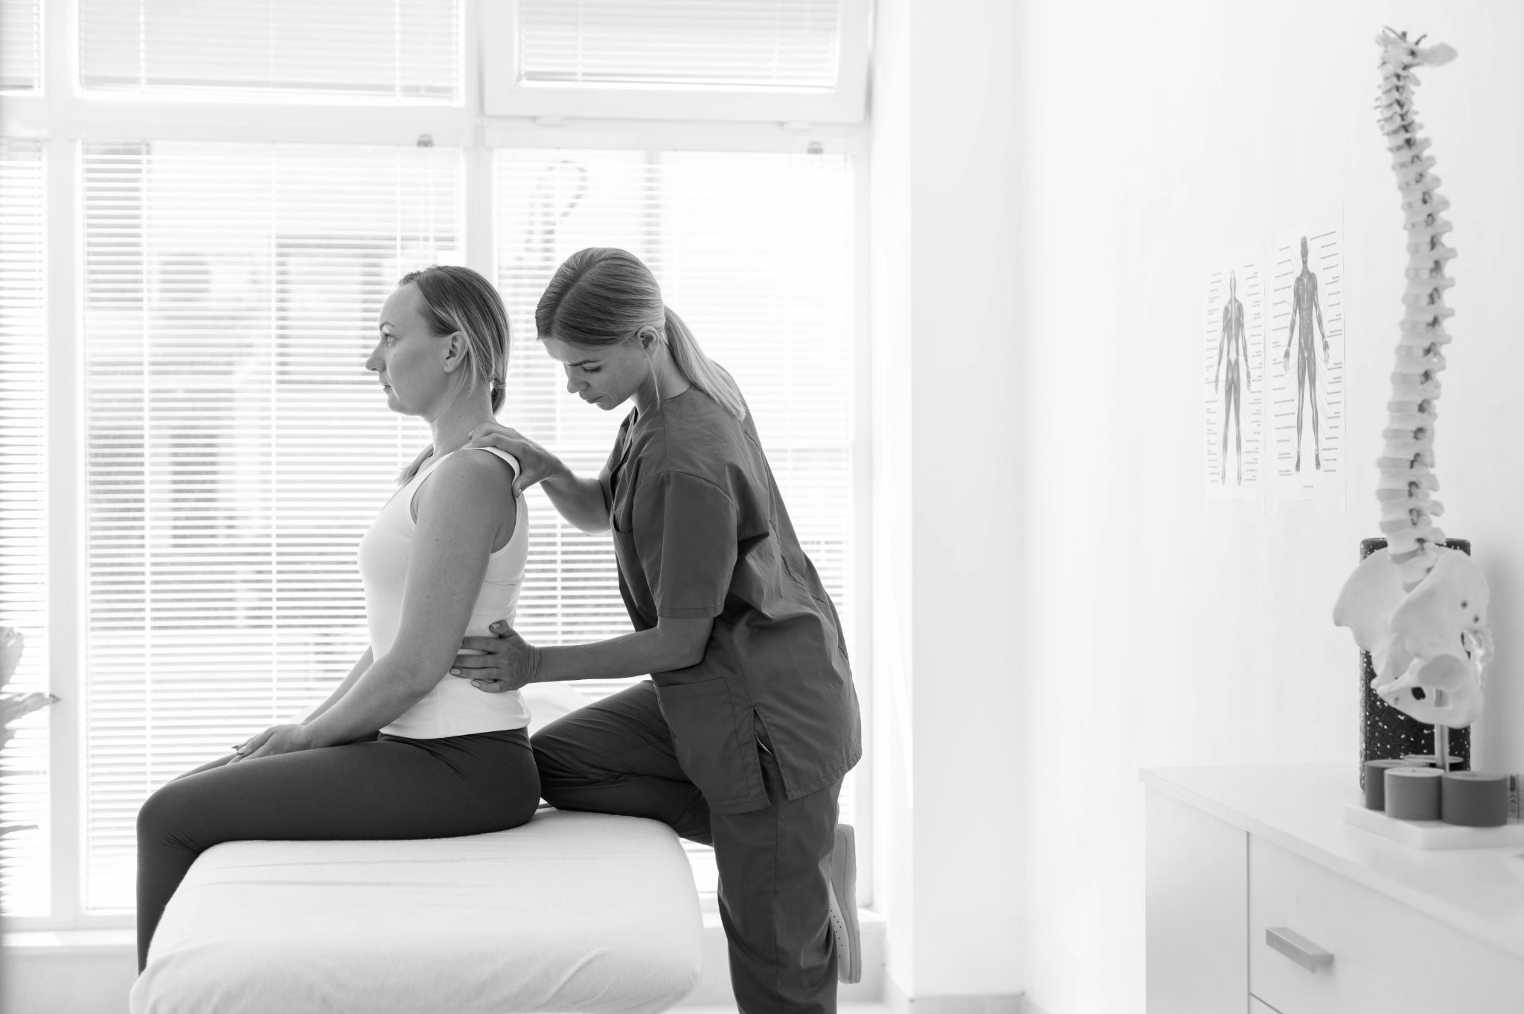
A brief story
Do you know what helps you make your point clear? Lists like this one:
They’re simple
You can organize your ideas clearly
You’ll never forget to buy milk!
And the most important thing: the audience won’t miss the point of your presentation

Slide 23
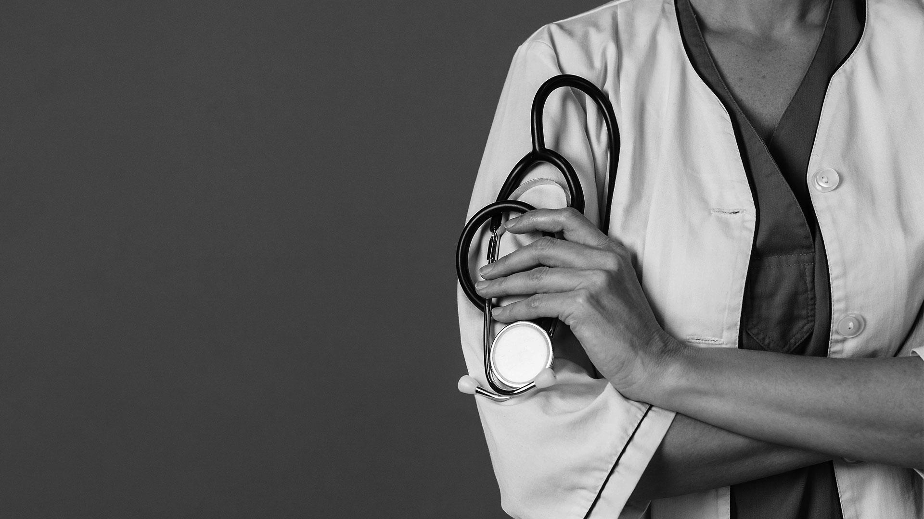
A picture is worth a thousand words

Slide 24
Areas we cover
Venus
Jupiter
Mars
Saturn
Venus is the second planet from the Sun
It’s the biggest planet in the Solar System
Despite being red, Mars is a cold place
Saturn is a gas giant and has several rings

Slide 25
Services
Mercury
Venus
Mars
Jupiter
Saturn
Neptune
Mercury is the closest planet to the Sun
Venus is the second planet from the Sun
Mars is actually a very cold place, not hot
Jupiter is the biggest planet of them all
It’s composed of hydrogen and helium
Neptune is the farthest planet from the Sun

Slide 26
Key accomplishments
2010 | 2015 | 2020
Mercury | Venus | Mars
Mercury is the smallest planet of them all | Venus is the second from the Sun. It’s hot there | Despite being red, Mars is actually a cold place

Slide 27
150,000
Big numbers catch your audience’s attention

Slide 28
Innovations
Mercury
Venus
Mars
It’s the closest planet to the Sun and the smallest one in the Solar System
Venus has a beautiful name and is the second planet from the Sun
Despite being red, Mars is actually a cold place. It’s full of iron oxide dust

Slide 29
Awards
2005
Jupiter
Jupiter is the biggest planet of them all
2010
Saturn
Saturn is a gas giant and has several rings
2015
Venus
Venus is the second planet from the Sun
2020
Mercury
Mercury is the closest planet to the Sun

Slide 30

Social media
You can replace the image on the screen with your own work. Just right-click on it and select “Replace image”

Slide 31


Our team
John Jimmy
Jenna Doe
You can speak a bit about this person here
You can speak a bit about this person here

Slide 32
Thanks!
Do you have any questions?
youremail@freepik.com
+91 620 421 838
yourcompany.com
Please keep this slide for attribution

Slide 33
Alternative resources
Here’s an assortment of alternative resources whose style fits the one of this template:
Photos
Osteopathist treating a young woman at the hospital
Young physiotherapist helping a patient with back problems
Woman having a physiotherapy session at a clinic I
Woman having a physiotherapy session at a clinic II
Woman having a physiotherapy session at a clinic II

Slide 34
Resources
Did you like the resources on this template? Get them for free at our other websites:
Photos
Female doctor at hospital with stethoscope
Close up on health worker
Woman working as doctor
Female osteopathist treating a girl at the hospital

Slide 35
Instructions for use
If you have a free account, in order to use this template, you must credit Slidesgo by keeping the Thanks slide. Please refer to the next slide to read the instructions for premium users.
As a Free user, you are allowed to:
- Modify this template.
- Use it for both personal and commercial projects.
You are not allowed to:
- Sublicense, sell or rent any of Slidesgo Content (or a modified version of Slidesgo Content).
- Distribute Slidesgo Content unless it has been expressly authorized by Slidesgo.
- Include Slidesgo Content in an online or offline database or file.
- Offer Slidesgo templates (or modified versions of Slidesgo templates) for download.
- Acquire the copyright of Slidesgo Content.
For more information about editing slides, please read our FAQs or visit Slidesgo School:
https://slidesgo.com/faqs and https://slidesgo.com/slidesgo-school

Slide 36
Instructions for use (premium users)
As a Premium user, you can use this template without attributing Slidesgo or keeping the "Thanks" slide.
You are allowed to:
Modify this template.
Use it for both personal and commercial purposes.
Hide or delete the “Thanks” slide and the mention to Slidesgo in the credits.
Share this template in an editable format with people who are not part of your team.
You are not allowed to:
Sublicense, sell or rent this Slidesgo Template (or a modified version of this Slidesgo Template).
Distribute this Slidesgo Template (or a modified version of this Slidesgo Template) or include it in a database or in any other product or service that offers downloadable images, icons or presentations that may be subject to distribution or resale.
Use any of the elements that are part of this Slidesgo Template in an isolated and separated way from this Template.
Register any of the elements that are part of this template as a trademark or logo, or register it as a work in an intellectual property registry or similar.
For more information about editing slides, please read our FAQs or visit Slidesgo School:
https://slidesgo.com/faqs and https://slidesgo.com/slidesgo-school

Slide 37
Fonts & colors used
This presentation has been made using the following fonts:
Lexend Exa
(https://fonts.google.com/specimen/Lexend+Exa)
Lato
(https://fonts.google.com/specimen/Lato)
#ffffff
#cccccc
#000000

Slide 38





Storyset
Create your Story with our illustrated concepts. Choose the style you like the most, edit its colors, pick the background and layers you want to show and bring them to life with the animator panel! It will boost your presentation. Check out how it works.
Pana
Amico
Bro
Rafiki
Cuate

Slide 39
Use our editable graphic resources...
You can easily resize these resources without losing quality. To change the color, just ungroup the resource and click on the object you want to change. Then, click on the paint bucket and select the color you want. Group the resource again when you’re done. You can also look for more infographics on Slidesgo.

Slide 42
JANUARY
FEBRUARY
MARCH
APRIL
MAY
JUNE
PHASE 1
Task 1
Task 2
PHASE 2
Task 1
Task 2
JANUARY
FEBRUARY
MARCH
APRIL
PHASE 1
Task 1
Task 2

Slide 45
...and our sets of editable icons
You can resize these icons without losing quality.
You can change the stroke and fill color; just select the icon and click on the paint bucket/pen.
In Google Slides, you can also use Flaticon’s extension, allowing you to customize and add even more icons.

Slide 46
Educational Icons
Medical Icons

Slide 47
Business Icons
Teamwork Icons

Slide 48
Help & Support Icons
Avatar Icons

Slide 49
Creative Process Icons
Performing Arts Icons

Slide 50
Nature Icons

Slide 51
SEO & Marketing Icons

Slide 52


